Slide 1
Exchanging Ideas: Oral Presentation
CSC 4195 Research Methodology
12
6
Fall 2021-2022
Dr. Afroza Nahar, Associate Professor
Department of Computer Science, Faculty of Science & Technology.
afroza@aiub.edu

Slide 2
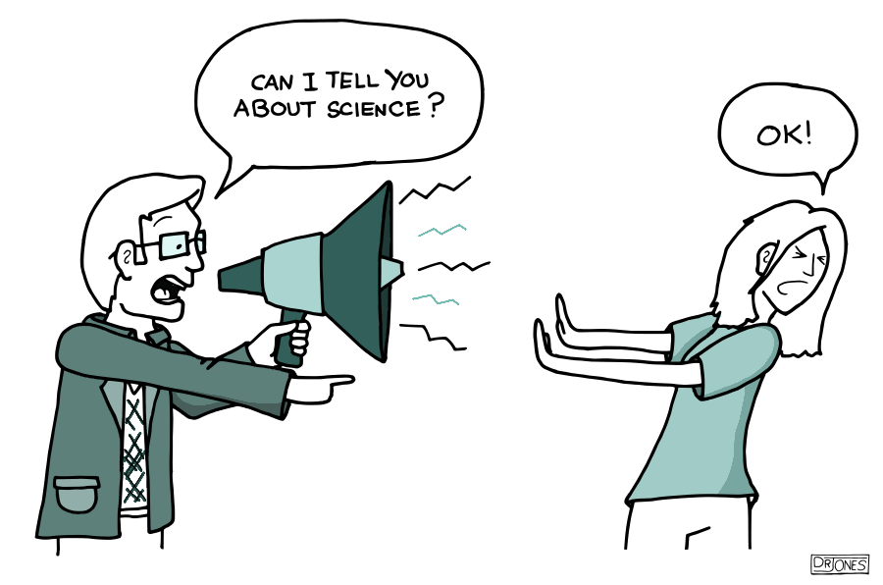
Importance of Oral Presentation
“The truly wise person is one who is able to explain complicated things in simple words”

Slide 3
Formats of Oral Presentations
Between scientists
Short communication, congress
Poster presentation
Lecture, Conference
Teacher-students
Teaching activities
Scientist-citizen
Interview (mass media)
Conference (general population)

Slide 4
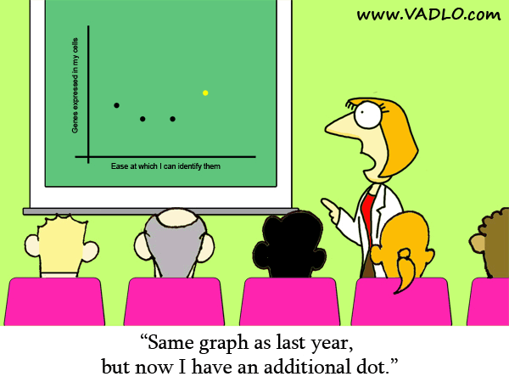
conferences
Why attend conferences?
To publish paper
To present research findings
To meet your reviewers
To meet other researchers
Share your research within your field
Get feedback that can make your work better
Each conference has a Technical Committee to assess papers
The time frame between six months and one year before the conference is held

Slide 5
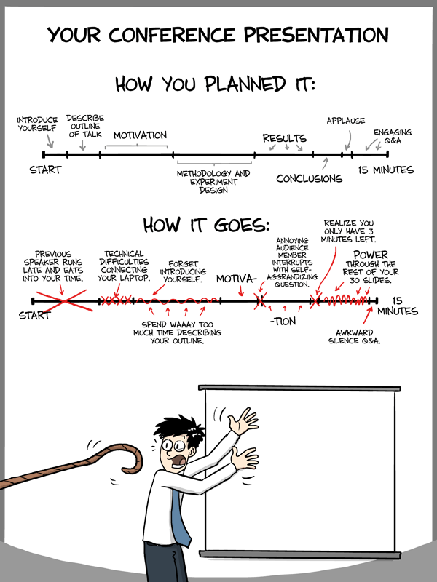
Preparing for Conference Presentation
Strict time limits given for presentation.
A session chair is responsible for the timely presentation of the papers allocated to the session.
Each speaker is allocated a time slot
The time limit is well known before the conference.

Slide 6
Preparation ...
One slide per minute
too many slides, difficult for the audience to follow.
Rule of thumb: 1 hour in preparation for 5 minutes of talking
More time to prepare a short version of presentation than a longer one
Structure:
Decide on a definite structure or format
talk without structure is a woolly mess
Simple structure
Take out unnecessary items
Timing issues
The oral presentation is usually a 12 to 15 minutes
Questions and answers 3 to 5 minutes
Exceeding time limit is not polite
If don’t have enough time, just skip slides, say less about each slide, or go directly to the conclusion.
Practice exactly as you plan to deliver it.

Slide 7
Preparation ...
For example: 10 minutes presentation time and 5 minutes Q&A
The total slide count: a maximum of 13 slides
Title/author/university (1 slide)
require little explanation apart from acknowledging the co-authors of the paper.
Outline (1 slide)
Give the presentation structure.
Introduction (1 slide)
Objectives/Motivation and Problem Statement (1 slide)
Theory (1–2 slides)
Experimental method (1–2 slides)
Results (3–5 slides);
Present key results
Do not cover all the results
Discussion and conclusions (1-2 slides).
The final two slides: a list of references and acknowledgements.
No verbal comments required
Backup Slides (1-3 slides)
Make few slides ready to answer expected questions.
Possible question areas are limitations in the methods or results, and future work.

Slide 8
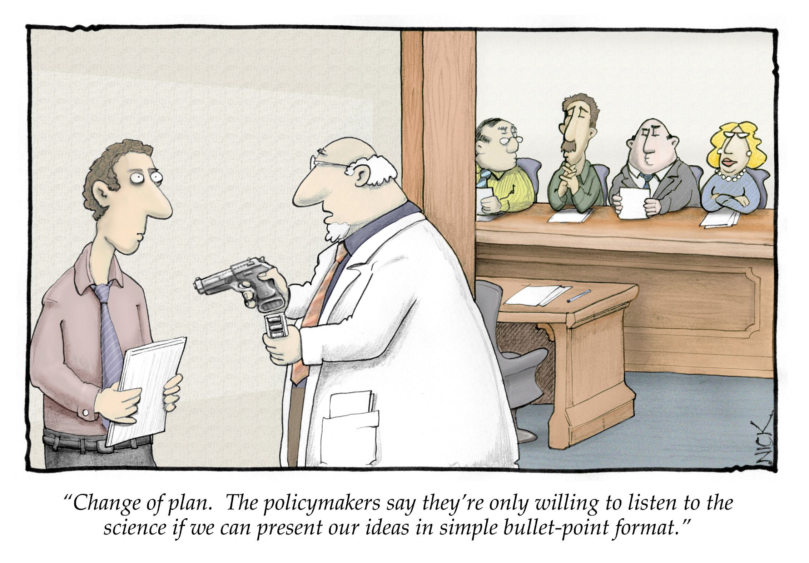
Preparation ...

Slide 9
Preparation ...
Font Size:
Your audience may be 70 feet away
Fonts should be 24 points or larger
Choosing a Font:
Don’t sacrifice readability for style
Your job is to communicate
Choosing a colour:
Light neutral colour background and black letters is considered the most readable.
Unwanted light affects colour contrast by turning dark reds and greens much lighter.
About 10% of people have difficulty with reds and greens.
Use Contrasting Colour:
A dark background with light text/light background with dark text is easily readable
Use drop shadows
Avoid busy backgrounds
Avoid using red text
AVOID ALL CAPS!

Slide 10


Slide 11
Preparing the presentation
Prepare the slides in advance
Show them to friends
When you think you are done read them again
Check all animations with the sound on ☺

Slide 12
Useful Equipment
Laser Pointer and Wireless Mouse
Extremely useful
Able to change pages from across the room
Point out key graphs and charts.
Microphone
Even if you talk loudly enough, use it.
A microphone will make sure the understandability
Place the microphone correctly.
Preparation
Pay attention to all details during the event
Arrive early
check venue and make any last minute adjustments.
It is very important that you pay attention to even the smallest details.

Slide 13
Preparing the presentation
Practice, practice, practice
Give a practice talk to a general audience
Give a practice talk to an audience of expert
Time your presentation (allow for speed up effect caused by nervousness)
Always assume technology will fail you. Have backups.

Slide 14
Delivering the talk
Be enthusiastic! If you aren’t why should the audience be?
Make eye contact with the audience
Identify a few “nodders” and speak to them
Watch for questions. Be prepare to digress or brush off when irrelevant

Slide 15
Delivering the talk…
Point at the screen not the computer
Do not read directly from the PPT or your notes
Have the “spill” for the first couple of slides memorized in case you go blank
Finish in time

Slide 16
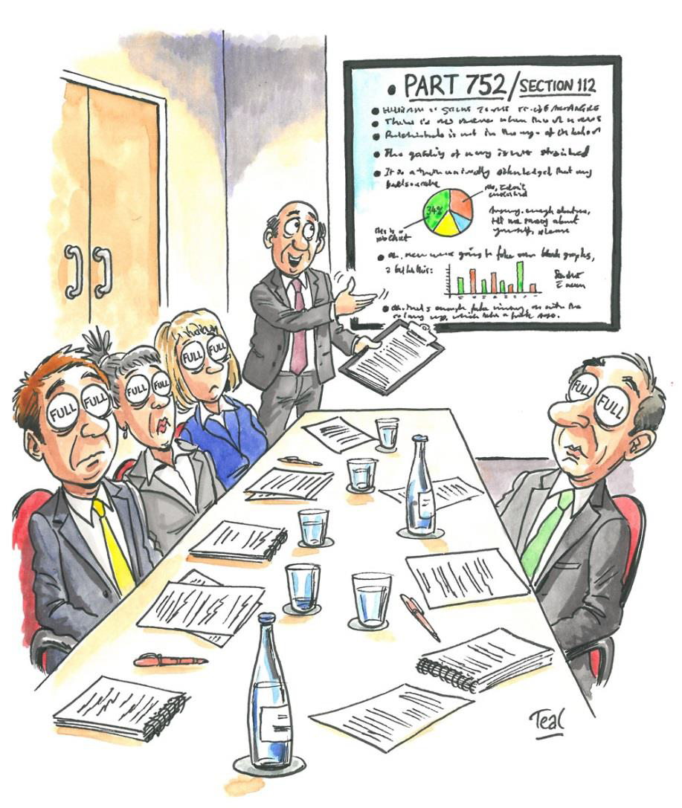
Delivery

Slide 17
Delivery..
In conference talks should have at least two goals:
Leave the audience with a clear picture of your contribution
Make them want to read your paper
Your presentation should not replace your paper, but make the audience want to look for it.
Talk about information in the paper that can’t be completely covered in the presentation.

Slide 18
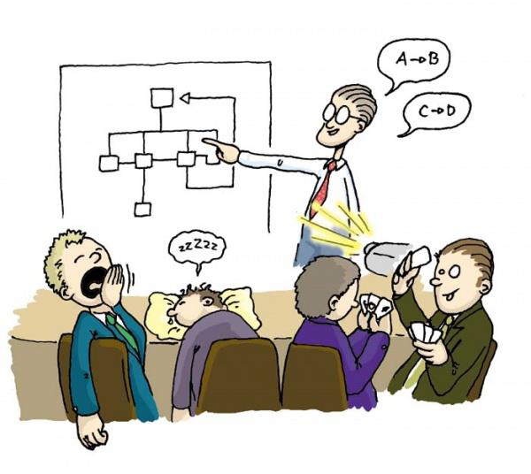
Delivery..
Why do some people give poor talks?
Poor speaking is a reaction of fear
Not like writing journal articles
Presentations are different communication
Good presentations require different skills

Slide 19
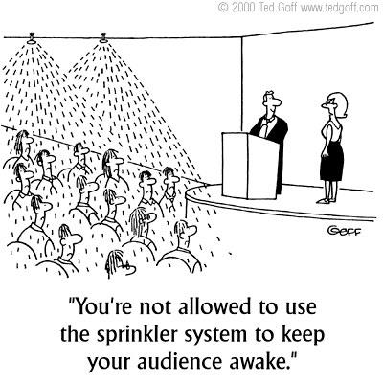
Delivery ...
Talk, instead of reading
Stand up
Move around
Make eye contact with your audience
Don’t only look at one side of the room
Imitate excellent speakers

Slide 20
Delivery ...
Walk purposefully and confidently to the front of the lecture room
Make sure that your facial expressions are natural
Do not hide behind the lectern
Pick three positions, one on centre stage, one to your right, and one to your left

Slide 21
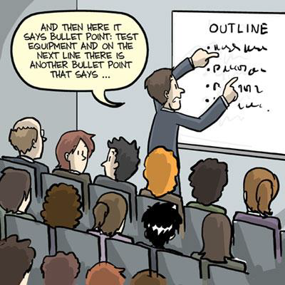
Delivery ...
Do not place your hands on your hips
Make the point with different explanations and in different ways
Plain Speech
Jokes – effective but do not offend others
Do not rush – speak more slowly and clearly than you normally would

Slide 22
Delivery ...
Voice
Volume:
Loud enough or too loud?
Adjust to the size of the room and make sure the people at the back can hear
Speed and fluency:
Slow enough so your audience can understand
Proper intonation
Do not leave long pauses while you are looking at your notes
Do not use fillers such as 'um' or 'er’

Slide 23
Delivery ...
Don’t write everything and read
Your PowerPoint presentation should:
Clarify ideas
Emphasize key points
Show relationships
Provide visual information to ensure the audience understands the message
Have a good outline of the presentation.
A good outline makes the audience curious to hear the details.
Outline also helps to follow the structure of the thinking.

Slide 24
How can I get better?
Practice every chance you can
Observe others
Steal good presentation ideas
Notice all the things that turned you off
Seek comments from friends and mentors

Slide 25
Delivery ...
Nervousness
Feeling nervous in front of an audience is natural
Smile and focus attention on members of audience who show interest
help you feel more confident
It is okay to say "I don't know"
The best antidote to nerves: act as though you feel fantastic

Slide 26
Delivery ...
How to minimize stage-fright?
Take a deep breath before taking the floor
Walk slowly to the front, pause and look at the audience before speaking
Remain calm
Rehearse the talk a number of times before the event
with and without an audience.
Memorize the first two sentences that will be spoken.
Use hand note cards.
Do not speak until the Chairperson of the session has introduced you.

Slide 27
Delivery ...
How to conclude presentation?
An energetic ending is critical to a successful presentation
Ending should be what the audience remembers best
Create a feeling of closing
Emphasize the main point
Deliver your message so it is easy to remember
At opening and ending, the presenter should show positive emotions
Avoid adding new points to the ending that you forgot.

Slide 28
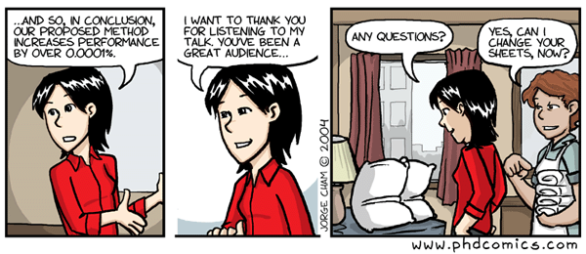
Delivery ...
Tips to develop confidence
Prepare
Practice
Rehearse
Focus on your audience
Simplify
Connect with your audience
Confident
Speech is over
try to honestly evaluate your performance
Find least successful aspect of your presentation and improve that point in next talk
Practice is only productive when you make a positive effort to improve

Slide 29
Handling questions
Different types – handle accordingly
Need clarification
Suggest something helpful
Want to engage in research dialog
Show that he/she is better than you
Anticipate questions (additional slides)
Don’t let them highjack the talk (postpone)

Slide 30
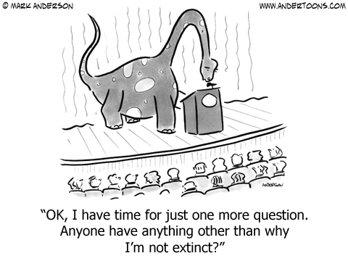
Question & Answer
Questions and answers are important for several reasons:
Get attention
Create interest
Get feedback
Make points easy to remember
Create audience interaction
Promote new thoughts

Slide 31
Question & Answer
Why do people ask questions?
To know the answer
To make a point
To impress the audience
To see if you know the answer
To see how you handle questions and the stress
To make you look bad (for example, if they are competing with you for a job)
To attack your methodology
Some ask questions that are in fact a personal attack (but not often)

Slide 32
Question & Answer
Prepare for criticism by telling your ideas to a critical friend.
Bring a list of references when answering questions.
Take notes of questions and suggestions.
If you are using slides, save several slides and use them to answer expected questions.
Sometimes question time is so exciting that you can’t answer all the questions with the time you have.
Tell people ways to contact you and when and how you will respond.
Think of ways to share these questions and answers with all members of the audience through an e-mail list or web site.

Slide 33
Question & Answer
Tips for handling Q&A session
Repeat the question in a large group or arrange for microphones so others can hear the question
Make sure you understand the question
Angry questions don’t have to be answered
Be friendly
Always keep your temper
Hostile questioner
Respond as if he/she were a friend
Slow down
Take a few seconds to think about the question
Listen carefully to the question and repeat it aloud
Make sure you understood the question correctly
Answer directly looking at the person asking the question
Give simple answers to simple questions
Lengthy reply – agree to discuss it later with anyone interested

Slide 34
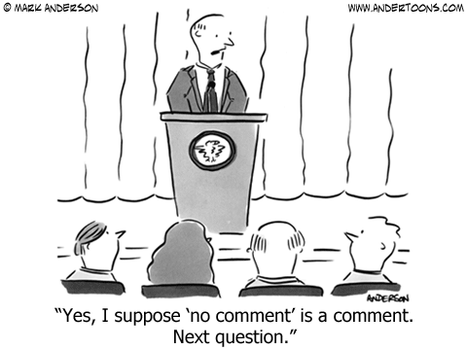
Handling Q&A session...

Slide 35
Handling Q&A session...
What if you don’t know the answer?
Suggest someone in the audience more qualified answer the question. “Professor X has studied this extensively.”
Delay, “That’s a good question...”
Ask a question: “Can you clarify what you mean?”
Admit you don’t know but will research it for them.
Repeat the question in a different way: “Is this what you are asking?” [Then say a question you can answer]
If you don’t have a good answer after these delaying
tactics, say: “Let’s talk about that after my talk.”

Slide 36
Handling Q&A session...
What if you don’t understand question?
If you don’t understand the English, ask the speaker to repeat the question.
If the questioner still asks and you still don’t understand, say, “Great question, but it’s quite specific to your field and does not concern everyone here, see me after the talk and we can go into more detail about it.”
Quickly move to another question or conclude your session.

Slide 37
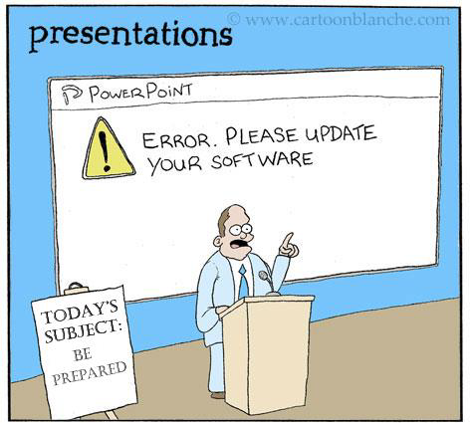
Presentation Problems
Computer problems
Many things can go wrong with the computer, the projector, the software, the connector cables, presentation, etc.
Don’t assume your host will have the same version of PowerPoint

Slide 38
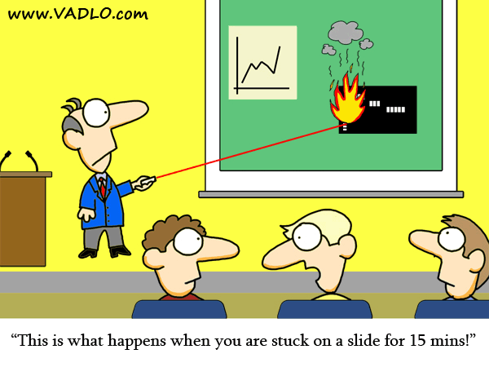
Presentation Problems
Bring backup
Begin making backups several days before the presentation.
Internet backup isn’t reliable, you can’t be sure you’ll have a connection.
Bring printed notes or outlines
In case the PC or projector dies
Be prepared to deliver your talk without the slides.
Bring printed notes.

Slide 39
Presentation Problems
Someone starts a private conversation while you are speaking
First, ask if there are questions.
Second, ask if you can do anything to clarify.
If not stop, continue your presentation but move nearer to them.
Notice your audience and respond to their needs
Notice the feedback.
If you’re not sure whether people can see or hear, ask someone in the back directly.
Take control of the environment
Audience will sometimes try to help you by turning off the lights and closing the windows when the projector is turned on.
Unless this is necessary, avoid it.
Dark rooms make people sleepy.

Slide 40
Some resources
http://research.microsoft.com/~simonpj/papers/giving-a-talk/writing-a-paper-slides.pdf
http://wit.tuwien.ac.at/research/tips/good_research_talk_slides.pdf
http://research.microsoft.com/~simonpj/papers/giving-a-talk/giving-a-talk-html.html
http://www.cse.buffalo.edu/~rapaport/howtowrite.html
http://www.iasted.org/conferences/formatting/Presentations-Tips.ppt

Slide 41
Some resources
How to prepare and present a conference presentation, http://blogs.baruch.cuny.edu/cacophony/2010/10/13/how-to-prepare-and-present-a-conference-presentation
Steve Wallace, How to Present a Paper at an Academic Conference, www.editing.tw/download/SpeechD.ppt
How to present a paper at a conference when. English is not your first language, http://aspirecongress.org/wp-content/uploads/2014/02/How-to-present-a-paper-at-a-conference-when-English-is-not-your-first-language-Robert-Norman.pdf

